Slide 1
Establishing of the project management structures
Milan Gocić
University of Niš
Kick-off meeting/ 21 December 2018
This project has been funded with support from the European Commission. This publication reflects the views only of the author, and the Commission cannot be held responsible for any use which may be made of the information contained therein.

Slide 2
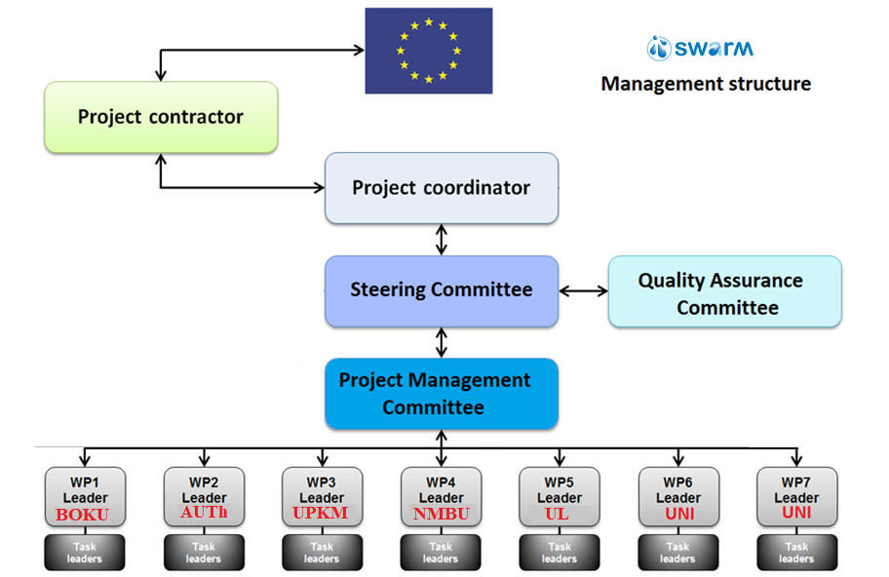
Strengthening of master curricula in water resources management
for the Western Balkans HEIs and stakeholders
www.swarm.ni.ac.rs

Slide 3
PC - Responsible for - overall project management (technical and operational), - communication and reporting to EACEA, - efficient use of the project grant, etc.
Strengthening of master curricula in water resources management
for the Western Balkans HEIs and stakeholders
www.swarm.ni.ac.rs

Slide 4
The QAC consists of 4 members from partner institutions experienced in quality assurance.
The QAC team is a direct support to the Project Coordinator in - monitoring and assessing the quality of the project and its results, - in development of Quality and Assurance Plan.
Strengthening of master curricula in water resources management
for the Western Balkans HEIs and stakeholders
www.swarm.ni.ac.rs

Slide 5
PMC - Responsible for the achievement of the project outcomes.
Strengthening of master curricula in water resources management
for the Western Balkans HEIs and stakeholders
www.swarm.ni.ac.rs

Slide 6
SC: decision-making body consisting of one representative (preferably the contact person) from each partner institution.
SC will meet twice a year (in combination with other project events due to cost efficiency) - to discuss and review the progress of project activities, - to make decisions, - to approve deliverables and - to agree on any risk contingency measures.
Strengthening of master curricula in water resources management
for the Western Balkans HEIs and stakeholders
www.swarm.ni.ac.rs

Slide 7
WP’s Leaders responsible for monitoring of the overall progress of the WP’s and their activities.
Strengthening of master curricula in water resources management
for the Western Balkans HEIs and stakeholders
www.swarm.ni.ac.rs

Slide 8
Task Leaders are in charge of monitoring the assigned activities, ensuring their quality level, timelines and timeliness, and active participation of other partners
Strengthening of master curricula in water resources management
for the Western Balkans HEIs and stakeholders
www.swarm.ni.ac.rs

Slide 9
Decision making process
Main Decision Making Body is the Steering Committee.
Steering Committee Meeting:
A simple majority of the SC members shall constitute a quorum.
Decision-making will be done by a simple majority of the present members (one vote per member).
Additionally, meetings can be arranged via video-conferencing or e-voting of the SC members, especially in the contingency of unexpected developments.
Strengthening of master curricula in water resources management
for the Western Balkans HEIs and stakeholders
www.swarm.ni.ac.rs

Slide 10
Decision making process
In case that the Project Coordinator has profound objections concerning the compliance of a taken decision with the grant agreement or the legal basis of the ERASMUS+ programme, the decision shall be frozen until the Project Coordinator clarifies the matter with the Executive Agency.
In case that no compliance should be asserted the decision will be cancelled.
Strengthening of master curricula in water resources management
for the Western Balkans HEIs and stakeholders
www.swarm.ni.ac.rs

Slide 11
Steering Committee
No. | Acronym | Name
1 | UNI | Milan Gocić
2 | BOKU | Michael Tritthart
3 | NMBU | Harsha Ratnaweera
4 | AUTh | Panagiotis Prinos
5 | UACEG | Petar Filkov
6 | UNIRIFCE | Barbara Karleuša
7 | UL | Maria Manuela Portela
8 | UNS | Srđan Kolaković
9 | UNSA | Emina Hadžić
10 | UNMO | Suad Špago
 |  | Mili Selimotić
11 | UPKM | Đurica Marković
12 | TCASU | Predrag Stanojević
13 | UoM | Goran Sekulić
14 | PWMC VV | Olivera Gavrilović
Strengthening of master curricula in water resources management
for the Western Balkans HEIs and stakeholders
www.swarm.ni.ac.rs

Slide 12
Project Management Committee
No. | Acronym | Name
1 | BOKU | Michael Tritthart
2 | AUTh | Panagiotis Prinos
3 | UPKM | Đurica Marković
4 | NMBU | Zakhar Maletskyi
5 | UL | Maria Manuela Portela
6 | UNI | Slaviša Trajković
7 | UNI | Milan Gocić
Strengthening of master curricula in water resources management
for the Western Balkans HEIs and stakeholders
www.swarm.ni.ac.rs

Slide 13
Quality Assurance Committee
No. | Acronym | Name
1 | UL | Maria Manuela Portela
2 | NMBU | Elisabeth Sundheim Hoff
3 | UACEG | Maria Mavrova-Guirguinova
4 | UNIRIFCE | Barbara Karleuša
Strengthening of master curricula in water resources management
for the Western Balkans HEIs and stakeholders
www.swarm.ni.ac.rs

